Slide 2
Chapter 4: Intermediate SQL part1- join to views

Slide 3
Chapter 4: Intermediate SQL
Join Expressions
Views
Transactions
Integrity Constraints
SQL Data Types and Schemas
Authorization
Notes:
1

Slide 4

Joined Relations
Join operations take two relations and return as a result another relation.
A join operation is a Cartesian product which requires that tuples in the two relations match (under some condition). It also specifies the attributes that are present in the result of the join
The join operations are typically used as subquery expressions in the from clause

Slide 5
Joined Relations
Join operations take two relations and return as a result another relation.
These additional operations are typically used as subquery expressions in the from clause
Join condition – defines which tuples in the two relations match, and what attributes are present in the result of the join.
Join type – defines how tuples in each relation that do not match any tuple in the other relation (based on the join condition) are treated.

Slide 6
Suppose we wish to display a list of all students, displaying their ID, and name, dept name, and tot cred, along with the courses that they have taken. The following SQL query may appear to retrieve the required information:
select * from student natural join takes;
We would thus not see any information about students who have not taken any course.

Slide 7
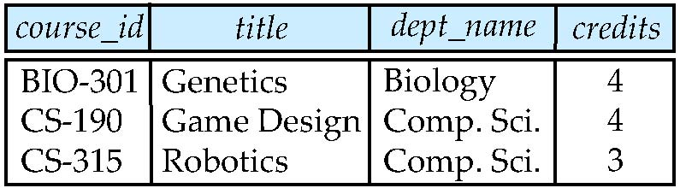
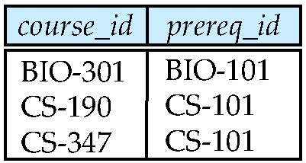
Join operations – Example
Relation course
Relation prereq
Observe that
prereq information is missing for CS-315 and
course information is missing for CS-437

Slide 8
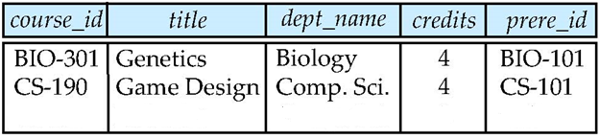
Natural or conditional Joins
course natural join prereq

Slide 9
Outer Join
More generally, some tuples in either or both of the relations being joined may be “lost” in this way.
An extension of the join operation that avoids loss of information.
The outer join operation works in a manner similar to the join operations we have already studied, but preserve those tuples that would be lost in a join, by creating tuples in the result containing null values.
Computes the join and then adds tuples from one relation that does not match tuples in the other relation to the result of the join.
Uses null values.

Slide 10
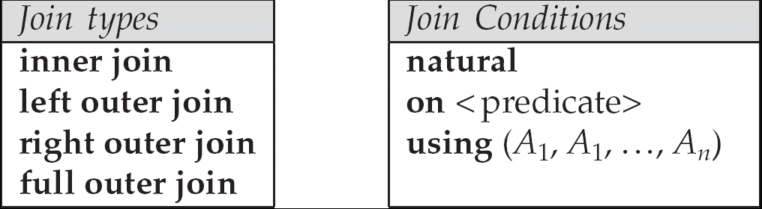
There are in fact three forms of outer join:
The left outer join preserves tuples only in the relation named before (to the left of) the left outer join operation
The right outer join preserves tuples only in the relation named after (to the right of) the right outer join operation.
The full outer join preserves tuples in both relations.

Slide 11
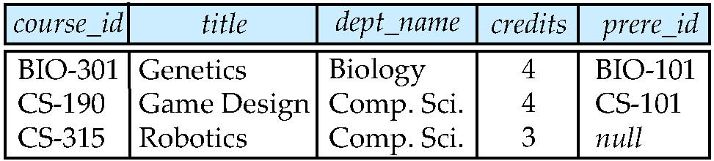
Left Outer Join
course natural left outer join prereq

Slide 12
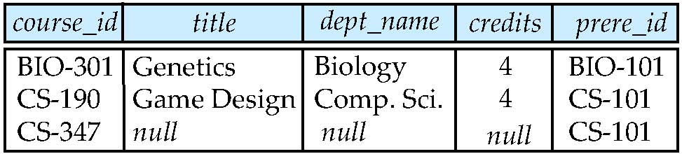
Right Outer Join
course natural right outer join prereq

Slide 13
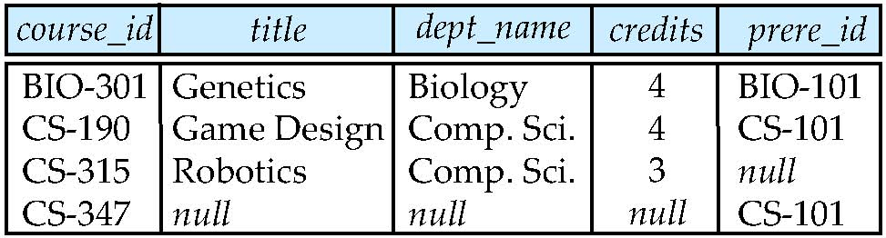
Full Outer Join
course natural full outer join prereq

Slide 14
“Display a list of all students in the Comp. Sci. department, along with the course sections, if any, that they have taken in Spring 2009; all course sections fromSpring 2009 must be displayed, even if no student from the Comp. Sci. department has taken the course section.” This query can be written as:
select * from (select * from student where dept name= ’Comp. Sci’)
natural full outer join (select * from takes where semester = ’Spring’ and year = 2009);

Slide 15
Join…using
To provide the benefit of natural join while avoiding the danger of equating attributes erroneously, SQL provides a form of the natural join construct that allows you to specify exactly which columns should be equated. This feature is illustrated by the following query:
select name, title from (instructor natural join teaches) join course using (course id);
The operation join . . . using requires a list of attribute names to be specified. Both inputs must have attributes with the specified names.
Consider the operation r1 join r2 using(A1, A2).

Slide 16
Join…on
The on condition allows a general predicate over the relations being joined.This predicate is written like a where clause predicate except for the use of the keyword on rather than where. Like the using condition, the on condition appears at the end of the join expression.
Consider the following query, which has a join expression containing the on condition.
select *from student join takes on student.ID= takes.ID;
The on condition above specifies that a tuple from student matches a tuple from takes if their ID values are equal.

Slide 17
The following SQL statement will select all customers, and any orders they might have:
SELECT Customers.CustomerName, Orders.OrderID FROM Customers LEFT OUTER JOIN Orders ON Customers.CustomerID = Orders.CustomerID;

Slide 18
Inner join
To distinguish normal joins from outer joins, normal joins are called inner joins in SQL. A join clause can thus specify inner join instead of outer join to specify that a normal join is to be used. The keyword inner is, however, optional.
The default join type, when the join clause is used without the outer prefix is the inner join.
select * from student join takes using (ID);
is equivalent to:
select * from student inner join takes using (ID);

Slide 19
The INNER JOIN keyword selects records that have matching values in both tables.
SELECT column_name(s) FROM table1 INNER JOIN table2 ON table1.column_name = table2.column_name;

Slide 20
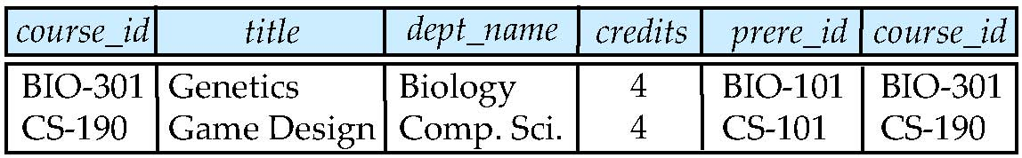
Joined Relations – Examples
course inner join prereq on course.course_id = prereq.course_id

Slide 21
What is the difference between the above, and a natural join?
Notice that we do not repeat those attributes that appear in the schemas of both relations; rather they appear only once.
Notice also the order in which the attributes are listed: first the attributes common to the schemas of both relations, second those attributes unique to the schema of the first relation, and finally, those attributes unique to the schema of the second relation.

Slide 22
Joined Relations – Examples
course natural right outer join prereq
course full outer join prereq using (course_id)

Slide 23
Views
In some cases, it is not desirable for all users to see the entire logical model (that is, all the actual relations stored in the database.)
Consider a person who needs to know an instructors name and department, but not the salary. This person should see a relation described, in SQL, by select ID, name, dept_name from instructor
A view provides a mechanism to hide certain data from the view of certain users.
Any relation that is not of the conceptual model but is made visible to a user as a “virtual relation” is called a view.

Slide 24
Does view occupy memory????
Actually view is a stored select statement and its code is stored in data dictionary.
It doesn't occupy space in the memory.
whenever view is called, the stored select statement executes and fetches the data from the base table.
If base table is deleted, view becomes invalid.

Slide 25
View Definition
A view is defined using the create view statement which has the form
create view v as < query expression >
where <query expression> is any legal SQL expression. The view name is represented by v.
Once a view is defined, the view name can be used to refer to the virtual relation that the view generates.
View definition is not the same as creating a new relation by evaluating the query expression
Rather, a view definition causes the saving of an expression; the expression is substituted into queries using the view.

Slide 26
Example Views
A view of instructors without their salary create view faculty as select ID, name, dept_name from instructor
Find all instructors in the Biology department select name from faculty where dept_name = ‘Biology’
The attribute names of a view can be specified explicitly as follows:
To Create a view of department salary totals create view departments_total_salary(dept_name, total_salary) as select dept_name, sum (salary) from instructor group by dept_name;

Slide 27
Views Defined Using Other Views
create view physics_fall_2009 as select course.course_id, sec_id, building, room_number from course, section where course.course_id = section.course_id and course.dept_name = ’Physics’ and section.semester = ’Fall’ and section.year = ’2009’;
create view physics_fall_2009_watson as select course_id, room_number from physics_fall_2009 where building= ’Watson’;

Slide 28
View Expansion
Expand use of a view in a query/another view
create view physics_fall_2009_watson as
(select course_id, room_number
from (select course.course_id, building, room_number
from course, section
where course.course_id = section.course_id
and course.dept_name = ’Physics’
and section.semester = ’Fall’
and section.year = ’2009’)
where building= ’Watson’;

Slide 29
Updating a view
The difficulty is that a modification to the database expressed in terms of a view must be translated to a modification to the actual relations in the logical model of the database.
create view faculty as select ID, name, dept_name from instructor
If a tuple is added as follows:
insert into faculty values (’30765’, ’Green’, ’Music’);
This insertion must be represented by an insertion into the relation instructor, since instructor is the actual relation from which the database system constructs the view faculty. However, to insert a tuple into instructor, we must have some value for salary.

Slide 30
There are two reasonable approaches to dealing with this insertion:
• Reject the insertion, and return an error message to the user.
• Insert a tuple (’30765’, ’Green’, ’Music’, null) into the instructor relation.

Slide 31
Update of a View
Add a new tuple to faculty view which we defined earlier
insert into faculty values (’30765’, ’Green’, ’Music’);
This insertion must be represented by the insertion of the tuple
insert into instructor values (’30765’, ’Green’, ’Music’, null)
into the instructor relation

Slide 32
Some Updates cannot be Translated Uniquely
create view instructor_info as select ID, name, building from instructor, department where instructor.dept_name= department.dept_name;
insert into instructor_info values (’69987’, ’White’, ’AB5’);
If id does not exists
what if no department is in AB5?
Suppose we Insert into instructor the (69987’, ’White’, null, null)
Insert in department(null, AB5, null)
In the absence of common dept name this view update will fail

Slide 33
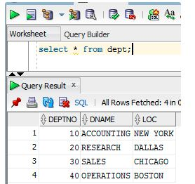
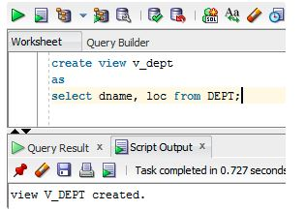
Updating main table through views

Slide 34
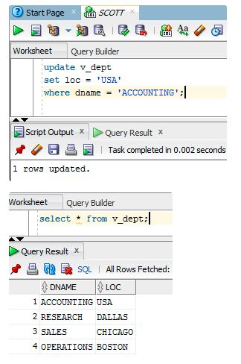
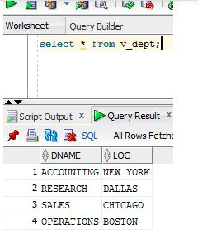

Slide 35
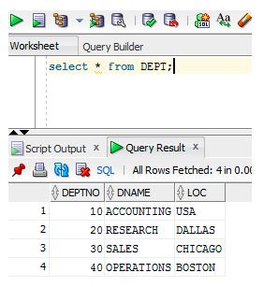

Slide 36
an SQL view is said to be updatable (that is, inserts, updates or deletes can be applied on the view) if the following conditions are all satisfied by the query defining the view:
The from clause has only one database relation.
The select clause contains only attribute names of the relation, and does not have any expressions, aggregates, or distinct specification.
Any attribute not listed in the select clause can be set to null
The query does not have a group by or having clause.

Slide 37
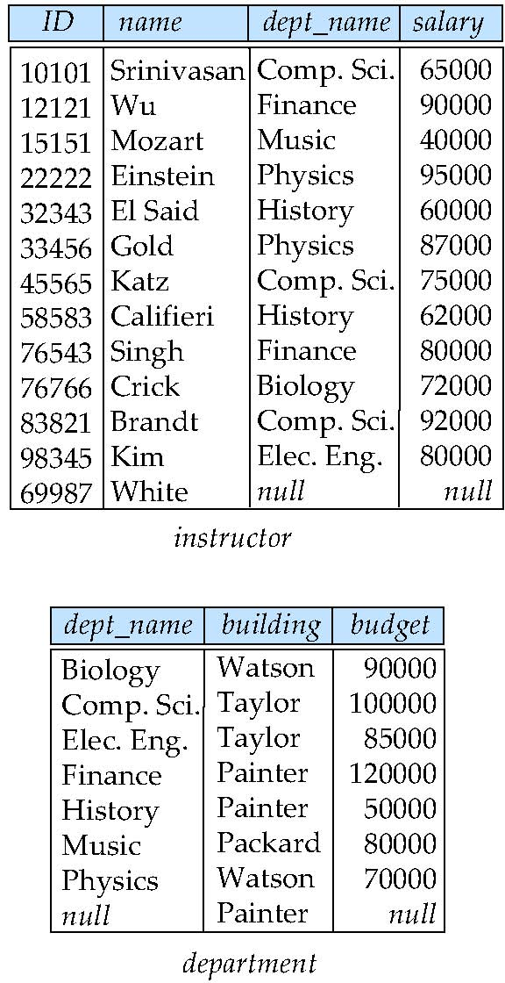
Taylor

Slide 38
with check option
create view history_instructors as select * from instructor where dept_name= ’History’;
What happens if we insert (’25566’, ’Brown’, ’Biology’, 100000) into history_instructors?

Slide 39
By default, SQL would allow the above update to proceed.
However, views can be defined with a with check option clause at the end of the view definition; then, if a tuple inserted into the view does not satisfy the view’s where clause condition, the insertion is rejected by the database system.
Updates are similarly rejected if the new value does not satisfy the where clause conditions.

Slide 40
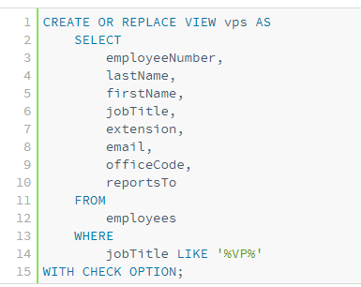

Slide 41
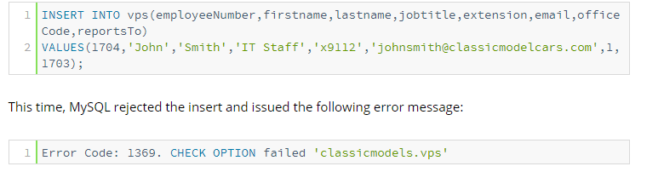

Slide 42
Materialized Views
Materializing a view: create a physical table containing all the tuples in the result of the query defining the view
If relations used in the query are updated, the materialized view result becomes out of date
Need to maintain the view, by updating the view whenever the underlying relations are updated.

